Slide 1


Division of Consumer Health Services Silver State Health Insurance Exchange
On-Exchange Carrier Monthly Meeting
April 14, 2026
NVHA.nv.gov

Slide 2

Agenda
Introductions
Six Month Look-Ahead
PY26 Enrollment Update
Public Option – BBSP & Market Stabilization Program Updates​
State & Federal Policy Updates ​
Plan Certification Updates​
April RCNI Submission​
Q&A

Slide 3
Introductions
Jennifer Krupp, Administrator, Consumer Health Services Division
Janel Davis, Exchange Executive Officer
Sarah Moses, Exchange Chief Operations Officer
Adam Plain, Agency Manager, Public Option
Rose Sutherland, Public Option
Max Borgman, Information Systems Manager
Beatriz Ramirez, Business Process Analyst, Recon Team Lead
Nathan Osborne, Compliance Manager
Joseph Filippi, Policy Manager
Katie Charleson, Communications Officer

Slide 4
Six Month Look-Ahead
April 2026
Intent to Sell forms were due and received on 4/1/26
Draft Letter to Issuers – feedback from carriers due 4/20/26
May 2026
Plan Year 2027 Binders prepared for initial Binder Submission due early June
Finalize Letter to Issuers
June 2026
Early June: Binders & Form submissions due in SERFF
Initial review of binder data submitted
July 2026
7/13: First data transfer from SERFF to the Nevada Health Link SBE Platform
7/13-8/21: Issuer Plan Preview begins
August 2026
Draft Plan Year 27 Issuer Agreements sent to issuers for review
Plan Preview ends and deadline for all plans to be verified

Slide 5
Six Month Look-Ahead, cont’d
September 2026 ​
Final Issuer Agreements get signed and sent​
Plans become certified in SERFF
October 2026
Consumer window shopping begins

Slide 6
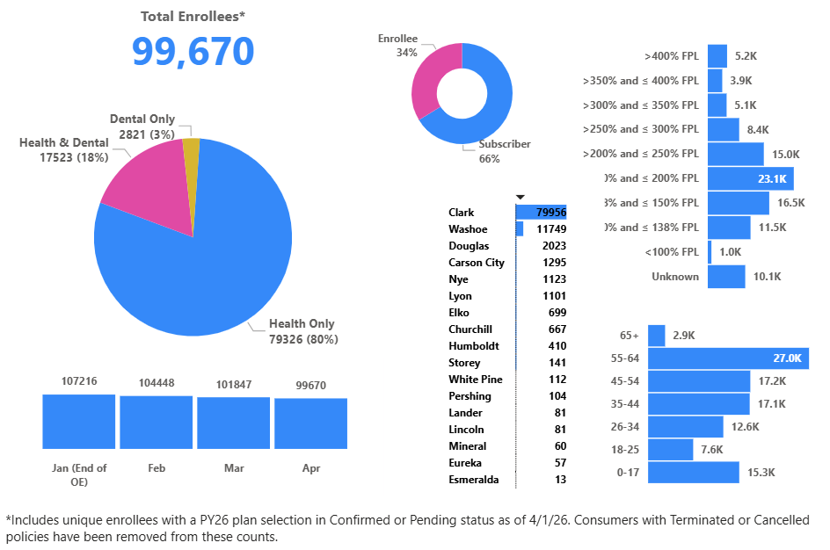
PY2026 Enrollment Update All Enrollees – All Counties

Slide 7
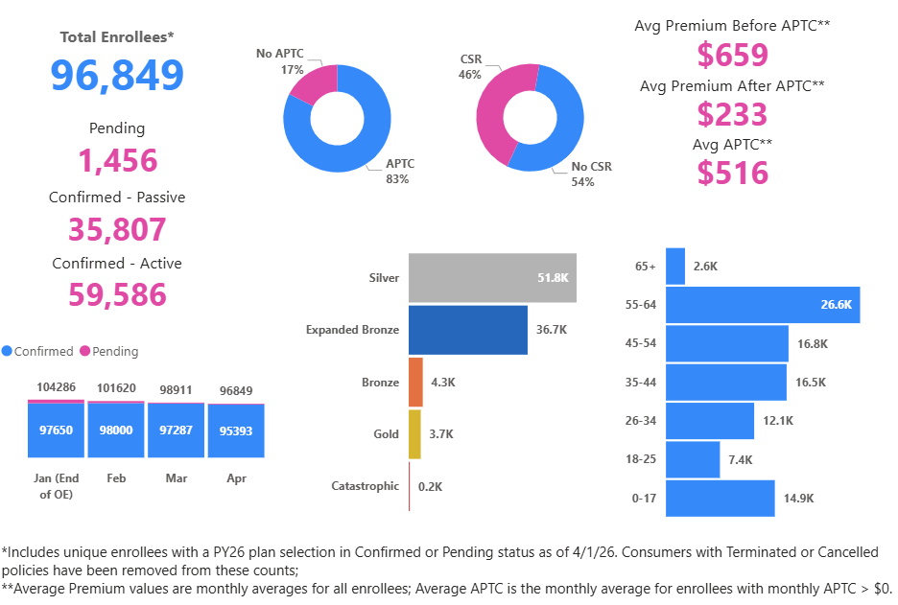
PY2026 Enrollment Update Health Enrollees – All Counties

Slide 8
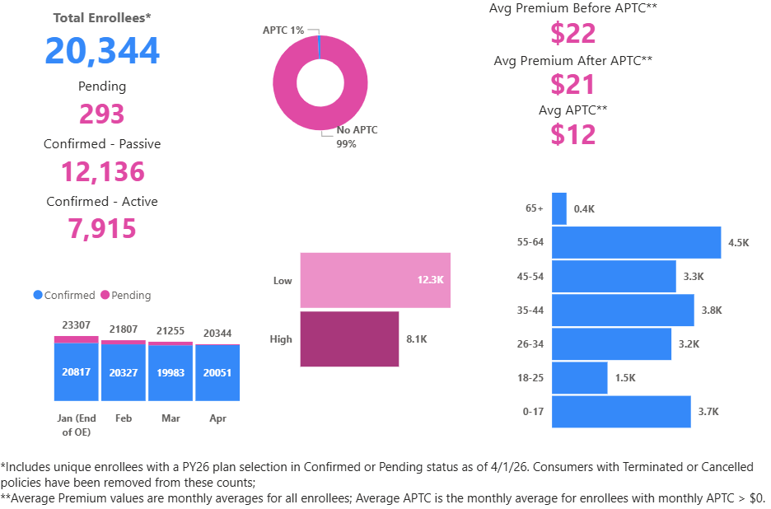
PY2026 Enrollment Update Dental Enrollees – All Counties

Slide 9
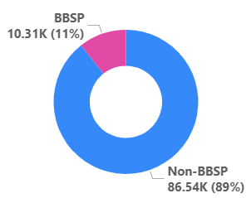

Public Option
Battle Born State Plans: 11% of Health Enrollment as of 4/1/26.
Market Stabilization Program​
State-Based Reinsurance Program:
Program guidance in development
Webinar and individual carrier calls coming soon
Begin developing your teams to discuss
Notes:
Rose presenting

Slide 10
PY27 NBPP Updates
CMS released plan year (PY) 2027 Notice of Benefit and Payment Parameters (NBPP) Proposed Rule
Proposed Rule Released: February 9, 2026
Comments Due to CMS: March 13, 2026
Final Rule Pending
Notes:
On February 9, 2026, CMS issued a highly anticipated 577-page proposed Notice of Benefit and Payment Parameters rule for 2027 that would, if finalized, make sweeping changes to marketplace coverage under the Affordable Care Act (ACA). The proposed rule was released relatively late compared to previous years, and the process for obtaining Marketplace plan certification for 2027 is already underway.
Although CMS provided a short 30-day window for the public to comment on the NBPP, the agency received 1044 comments, almost 4 times the number of comments received on the 2026 proposed rule.
SSHIX is continuing to plan for implementation of the final rule. Impacts to carriers will be relayed as soon as the rule is finalized.
Among the key proposals:
The proposed rule would implement provisions of New Federal Law (H.R. 1)
Such as narrowing eligibility for premium tax credits (PTCs) for many non-citizen lawfully present immigrant categories. In addition, the proposed rule implements the elimination of APTC eligibility for individuals whose household income is below 100% of the Federal Poverty Level (FPL) and who are ineligible for Medicaid due to immigration status.
State-based marketplace transition requirements would be removed, giving states more flexibility (and less federal oversight) when establishing SBMs while also permitting states to privatize eligibility and enrollment functions. The rule also requires SBEs establish an annual process to measure improper APTC payments administered by the SBE.
Revisiting Marketplace Integrity Rules
CMS revisits policies from the Marketplace Integrity and Affordability rule, including income verification and eligibility documentation requirements that had been legally challenged and court-stayed for 2026. The proposal seeks to reinstate these rules for 2027. The proposed rule would permanently require consumers whose income can’t be automatically verified to provide more documentation — expanding paperwork and verification steps for consumers.
Network Adequacy
The proposed rule would create newly-allowable “non-network” plans to certify as QHPs, which place responsibility on consumer to shop for services from a wide range of providers to determine the best price. The rule would also scale back network adequacy oversight requirements, including federal time and distance standards and expand state authority to oversee network adequacy and essential community provider reviews; I will note that Nevada will retain existing network adequacy standards as outlined in NAC.
Essential Health Benefits (EHBs)
The proposal would also require states to defray costs of most post-2011 state-mandated benefits.
High-Deductible Plans
The proposed rule would create new pathways for individuals to enroll in high-deductible plans by raising out-of-pocket cost-sharing limitations and making catastrophic plans available to more people; the rule would also allow insurers to offer multi-year catastrophic plans with terms up to 10 years.

Slide 11
Plan Certification Update
The Draft Plan Year 2027 Letter to Issuers was sent out Friday, March 20, 2026, with a 30-day public comment period due by Monday, April 20, 2026. The Final Letter to Issuers will be sent out and published on the Carrier Resources page of Nevada Health Link following final edits and comments.
Binder Submission in SERFF is due June 1, 2026.

Slide 12
April RCNI Submission
The next RCNI Submission Deadline is Monday, April 20th.
Carriers are expected to submit an RCNI for Plan Year 2026. ​
SSHIX has published a calendar of 2026 Monthly RCNI Submission Deadlines to Nevada Health Link’s Carrier Resources Page.
Month | Submission Deadline | 2027 RCNI | 2026 RCNI | 2025 RCNI
January 2026 | Monday, January 19 |  | X | X
February 2026 | Thursday, February 19 |  | X | X
March 2026 | Thursday, March 19 |  | X | X
April 2026 | Monday, April 20 |  | X
May 2026 | Thursday, May 21 |  | X
June 2026 | Thursday, June 18 |  | X
July 2026 | Monday, July 20 |  | X
August 2026 | Thursday, August 20 |  | X
September 2026 | Monday, September 21 |  | X
October 2026 | Monday, October 19 |  | X
November 2026 | Thursday, November 19 | X | X
December 2026 | Monday, December 21 | X | X | X

Slide 13
Questions?
Please submit questions re: EDI/Reconciliation or Carrier Connector to the SSHIX Recon Team at: reconsupport@nvha.nv.gov
Please submit questions re: Plan Certification to SSHIX Plan Certification Manager at: pmanagement@nvha.nv.gov
Please submit Policy questions to Joseph Filippi at: jfilippi@nvha.nv.gov

